Slide 1
Linux Basics

Slide 2
Working with Shell – Part 1
Linux Shell
The Home Directory
Command Prompt
Commands and Arguments
Notes:
What is a shell?
Linux shell is a program that allows text-based interaction between the user and the operating system, this interaction is carried out by typing commands into the interface and receiving the response in the same way.
The Linux shell is a powerful tool with which you can navigate between different locations within the system, however when you login to the shell the very first directory you were take into is your home directory

Slide 3
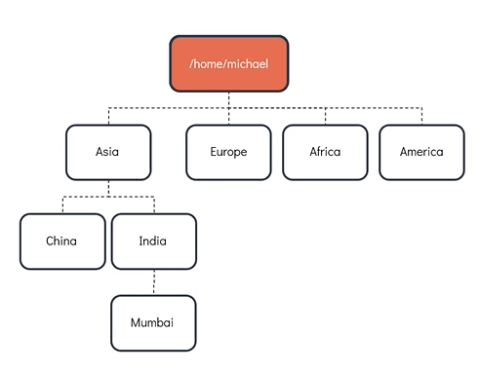
Basic Commands
Notes:
To print the present working directory. Run pwd command
To see the contents of the directory. Run ls command
To make (or) create a directory. Run mkdir command
To change a directory from the current directory. Run cd <directory_name>
To recursively created directories. Run mkdir -p <directory_name1>/<sub_directory_of_name1>
To go back to one directory up. Run cd ..

Slide 4
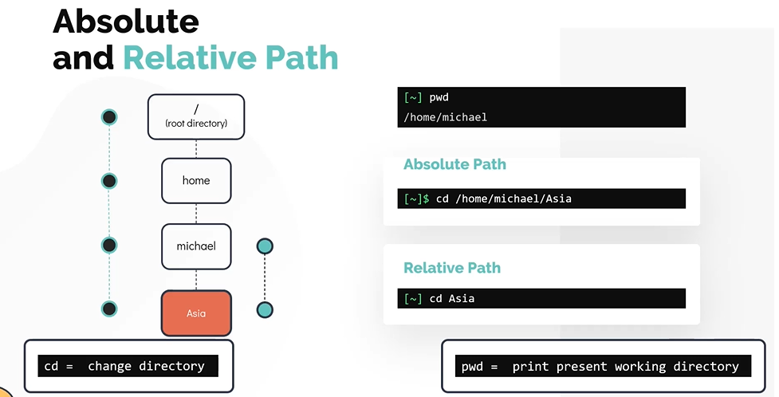
Absolute and Relative Path
Notes:
Difference Between Absolute and Relative Path
Absolute Path : An absolute path is defined as specifying the location of a file or directory from the root directory(/).
Relative Path : Relative path is defined as the path related to the present working directly(pwd).
To change to a directory with absolute path. Run cd <directory_path>
To Change to a directory with relative path. Run cd <directoryName>

Slide 5
Bash Shell
There are different types of shells in linux, some of the popular ones are below
Bourne Shell (sh)
C Shell (csh or tsh)
Korn Shell (ksh)
Z Shell (zsh)
Bourne again shell (Bash)
Bash environment variables
Path Variable
Notes:
To check the shell being used. Use the command echo $SHELL
$ echo $SHELL
Bash supports command auto-completion. What this means is bash means to auto-complete commands for you if you type part of it and press the tab key
Use the history command to list the previous run commands that you ran earlier
To print SHELL environment variable
Speaking about the environment variables, when a user issues an external command into the shell, the shell uses path variable to search for these external commands
To see the directories defined in path variable. Use the command echo $PATH.
To check if the location of the command can be identified. Use the which command
Syntax: which <command>
In Bash we can set custom aliases for the actual commands

Slide 6
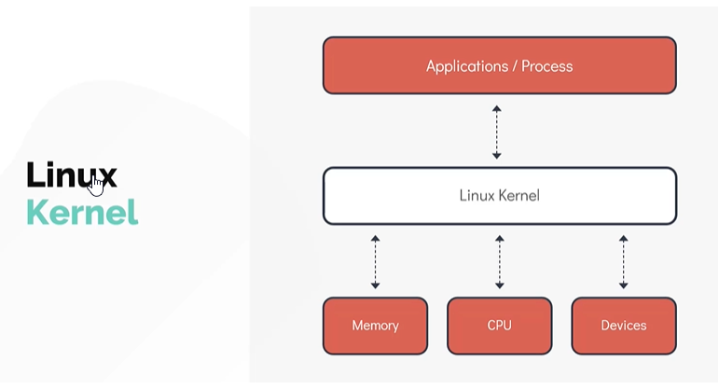
Linux Core Concepts - Kernel
Notes:
If you have worked with any operating system, you have run into the term kernel.
The Linux kernel is monolithic, this means that the kernel carrries out CPU scheduling, memory management and several operations by itselfs.
The Linux Kernel is also modular, which means it can extends its capabilities through the use of dynamically loaded kernel modules
The Kernel is responsible for 4 major tasks
Memory Management
Process Management
Device Drivers
System calls and Security
Use uname command to get the information about the kernel (by itself it doesn't provide much information except that the system uses the Linux Kernel.
$ uname
Use the uname -r or uname comamnd and option to print the kernel version
$ uname -r $ uname -a

Slide 7
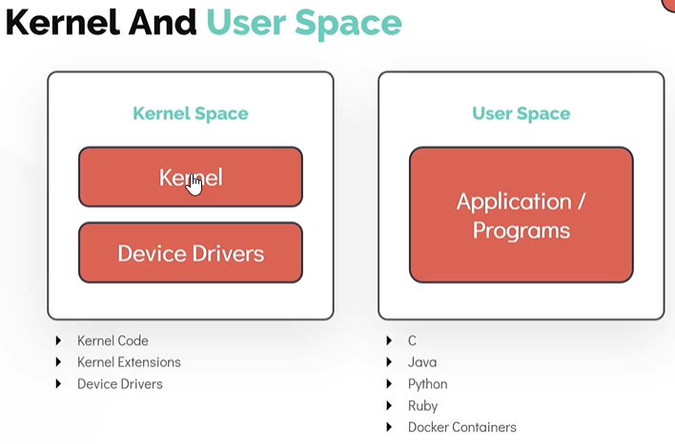
Linux-Core-Concepts – Kernel and User Space
Notes:
One of the important functions of the linux kernel is the Memory Management . We will now see how memory is seperated within the linux kernel
Memory is divded into two areas.
Kernel Space
Kernel Code
kernel Extensions
Device Drivers
User Space
C
Java
Python
Ruby e.t.c
Docker Containers

Slide 8
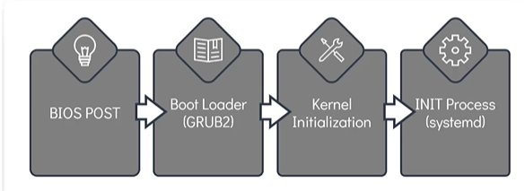
Linux-Core-Concepts – Boot Sequence
The boot process can be broken down into four stages
BIOS POST
Boot Loader (GRUB2)
Kernel Initialization
INIT Process
Notes:
How to initiate a linux boot process?
This can be achieved in one of the two ways.
The first method is to start a linux device which is in a halted or stopped state
Second method is to reboot or reset a running system
BIOS POST
The first stage, called BIOS POST has very little to do with linux itself.
POST Stands for Power On Self Test.
In this stage, BIOS runs a POST test, to ensure the hardware components that are attached to the device are functioning correctly, if POST fails the computer may not be operable and the system will not be proceed to next stage of the boot process
Boot Loader
The next stage after BIOS POST is Boot Loader after successful of POST test.
BIOS loads and executes the boot code from the boot device, which is located in the first sector of the harddisk. In Linux this is located in the /boot file system.
The boot loader will provide the user with the boot screen, often with multiple options to boot into. Such as Microsoft windows O.S or Ubuntu 18.04 O.S in an example of a dual boot system.
Once the selection is made at the boot screen, boot laoder loads the kernel into the memory supplies it with some parameters and handsover the control to kernel
A popular example of the boot loader is GRUB2 (GRand Unified Bootloader Version 2). Its a primary boot loader now for most of the operating system.
Kernel Initialization
After the selected kerenl is selected and loads into the memory, it usually decompress and then loads kernel into the memory.
At this stage, kernel carries out tasks such as initializing hardware and memory management tasks among other things.
Once it is completely operational , kernel looks for INIT Process to run. Which sets up the User Space and the process is needed for the environment.
INIT Process
In most of the current day linux distribution, the INIT function then calls the systemd daemon.
The systemd is responsible for bringing the linux host to usable state.
systemd is responsible for mounting the file systems, starting and managing system services.
systemd is the universal standard these days, but not too long ago another initialization process called system V (five) init was used. It is also called **Sys5
For example these were used in RHEL 6 or CentOS 6 distribution
Once of the key advantages of using systemd over system V(five) init is that it reduces the system startup time by parallelizing the startup of services.

Slide 9
Linux-Core-Concepts – Run Levels
Systemd Targets (Run Levels)
We can setup the server to boot either into graphical mode or non-graphical mode. Linux can run in multiple modes and these modes are set by something called runlevel
The operation mode which provide a graphical interface is called runlevel 5
The operation mode which provide a non-graphical mode is called runlevel 3
Notes:
To see the operation mode run in the system. Run the command runlevel from the terminal
$ runlevel

Slide 10
Linux-Core-Concepts – File Types
Everything is a file in Linux.
Every object in linux can be considered to be a type of file, even a directory for example is a special type of file.
There are three types of files.
Regular File
Directory
Special Files
Notes:
Special files are again catagorized into five other file types.
Character Files
These files represent devices under the /dev file system.
Examples include the devices such as the keyboard and mouse.
Block Files
These files represent block devices also located under /dev/ file system.
Examples include the harddisks and RAM
Links
Links in linux is a way to associate two or more file names to the same set of file data.
There are two types of links
The Hard Link
The Soft Link
Sockets
A sockets is a special file that enables the communication between two processes.
Named Pipes
The Named Pipes is a special type of file that allows connecting one process as an input to another
Let us now see how to identify different file types in Linux.
One way to identify a file type is by making use of the file command.
$ file /home/michael $ flle bash-script.sh $ file insync1000.sock $ file /home/michael/bash-script
Another way to identify a file type is by making use of the ls -ld command
ls -ld /home/michael ls -l basg-script.sh

Slide 11
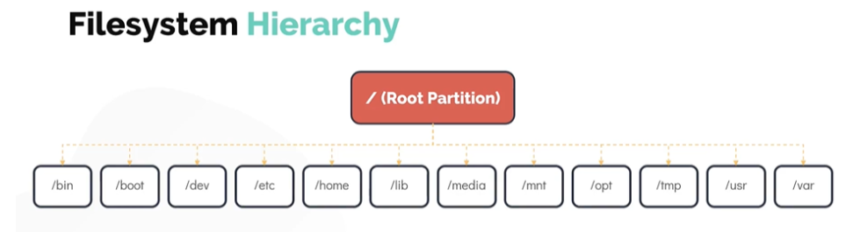
Linux Core Concepts – Filesystem Hierarchy
Notes:
Linux uses single rooted, inverted tree like file system/home : It is the location that contains the home directories for all users, except the root user (root user home directory is located at /root)
/opt : If you want to install any third party programs put them in the /opt filesystem.
/mnt : It is the default mount point for any partition and it is empty by default. It is used to mount filesystems temporarly in the system
/tmp : It is used to store temporary data
/media : All external media is mounted on /media
/dev : Contains the special block and character device files
/bin : The basic programs such as binaries cp, mv, mkdir are located in the /bin directory
/etc : It stores most of the configuration files in Linux.
/lib : The directory /lib and /lib64 is the place to look for shared libraries to be imported into your program
/usr : In older systems, /usr directory is used for User Home Directories, however in the modern linux operating systems it is the location where all user land applciations in their data reside
/var : It contains variable data like mails, log files
To print all the mounted filesystems, run df (disk filesystem) command
$ df -hP

Slide 12
Working With Shell – Part 2
File Compression and Archival
Viewing file sizes
Archiving Files
Compression
Notes:
The du command, which stands for disk usage is a popular command to inspect the size of the file.
du with -sk shows the size of a file or directory in Kilobytes
$ du -sk test.img
du with -sh shows the size of a file or directory in human readable format
$ du -sh test.img
we can also use long list , ls -lh to print the size of the file.
$ ls -lh test.img
Let us know take a look at widely used utility called tar
tar is used to group multiple files and directories into a single file. Hence it is specially used for archiving data.
tar is an abrevation for tape archive.
Files created with tar are often called tarballs.
To archive a file or directory. Use tar command followed by -c to create an archive and the -f is used to specify the name of the tar file to be created. These is followed by files or directories to be archive.
$ tar -cf test.tar file1 file2 file3 $ ls -ltr test.tar
The tar command followed by -tf option followed by the tar filename is used to see the contents of the tarball.
$ tar -tf test.tar
The tar command followed by -xf option followed by the tar filename is used to extract the contents from the tarball.
$ tar -xf test.tar
The tar command followed by -zcf option is used to compress the tarball to reduce its size.
$ tar -zcf test.tar
Compression is the technique used to reduce the size consumed by a file or a dataset.
To reduce the size of a file or directory in the linux file system, there are commands specificly used for compression.
Let us now look at the three popular ones
bzip2 (.bz2 extension)
gzip (.gz extension)
xz (.xz extension)
$ bzip2 test.img $ gzip test1.img $ xz test2.img
The space of the compressed files created by these three commands depends on a few factors, such as the type of data being compressed, the other factors that effect the size are the compression algorithm used by these commands and the compression level used.
The compressed files can be uncompressed by using the below commands
bunzip2
gunzip
unxz
$ bunzip2 test.img $ gunzip test1.img $ unxz test2.img

Slide 13
Working With Shell – Part 2
Searching for files and Patterns
locate
find
grep
Notes:
Lets say you want to find the files with the name City.txt. Easiest way to do this is to make use of locate command.
Run locate command followed by the filename you are searching as an argument. This should return all paths matching the pattern.
$ locate City.txt
The downside of the locate command is it depends on a database called mlocate.db for querying the filename.
If you have just installed linux or if the file you are trying to locate was created recently. The locate command may not give you useful results. This is because it is possible that the DB is not been updated yet.
To manually update the DB, run the command updatedb and then run the locate command again
$ sudo updatedb
Please note that the updatedb command needs to be run as root user to work.
Another way to do this is make use of the find command. Use the find command followed by the directory under which you want to search. To search file by a name use the -name option followed by the name of the file.
$ find /home/michael -name City.txt
Grep
To search within files, the most popular command in linux is grep.
Grep is commonly used to print lines of a file matching a pattern but it also offers a variety of other options as well.
The grep command is case-sensitive
To search for the word second from the sample.txt
$ grep second sample.txt
To search for the word capital with case-insensitive use -i flag.
$ grep -i capital sample.txt
To search for a pattern recursively.
$ grep -r "thrid Line" /home/michael
To print the lines that don't matches the pattern
$ grep -v "printed" sample.txt
What if you want to match a pattern that form a whole word?
To search for the whole word called exam. Use grep followed by -w flag
$ grep -w exam examples.txt
You can also combine multiple options together. For example, to reverse the search and print all lines of the same file that doesn't match the whole word exam. Use grep -vw
$ grep -vw exam examples.txt
To print the number of lines after and before matching a pattern. Use grep command with -A and -B flags respectively.
$ grep -A1 Arsenal premier-league-table.txt $ grep -B1 4 premier-league-table.txt

Slide 14
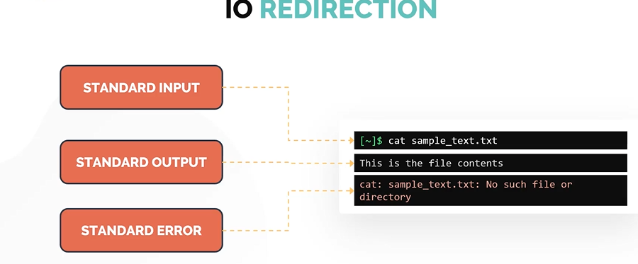
Working with Shell – Part 2
IO Redirection
There are three data streams created when you launch a Linux command.
Standard Input (STDIN)
STDIN is the standard input stream which accepts text as an input.
Standard Output (STDOUT)
Text output is delivered as STDOUT or the standard out stream
Standard ERROR (STDERR)
Error messages of the command are sent through the standard ERROR stream (STDERR)
Notes:
REDIRECT STDOUT
To redirect STDOUT to a file instead of printing it on the screen.
$ echo $SHELL > shell.txt
To append STDOUT to an exisiting file
$ echo $SHELL >> shell.txt
REDIRECT STDERR
To redirect just the ERROR message we need to use 2 followed by forward arrow > symbol and then the name of the filename in which the errors are written.
$ cat missing_file 2> error.txt
To append the STDERR to the exisiting file
$ cat missing_file 2>> error.txt
If you want to execute and not print ERROR messages on the screen even if it generates a standard ERROR. You can redirect to /dev/null
$ cat missing_file 2> /dev/null
Command Line Pipes
Command Line Pipes allow the linking of multiple commands.
In simple terms, pipes allows the first commands standard output to be used as the standard input for the second command.
The pipes are defined using vertical bar symbol (|).
$ grep Hello sample.txt | less
Another command to work with STDIN and STDOUT is the tee command.
Instead of the redirect operator, we can use the command line pipe (|) followed by tee command.
$ echo $SHELL | tee shell.txt
Use tee with -a option, to append instead of overwritting it
$ echo "This is the bash shell" | tee -a

Slide 15
Working with Shell – Part 2
Vi Editor
Command Mode
Insert Mode
Last Line Mode
Notes:
There are several options available, we will be focusing on the VI Editor.
Most popular text editor in linux is the VI Editor.
The VI EDITOR is available in all most all of the linux distribution out of the box.
The command to open the vi editor is vi followed by the filename that you want to create or append.$ vi /home/michael/sample.txt
The VI EDITOR has three operation modes.
Command Mode
When the vi editor opens a file, it always goes to the COMMAND MODE first.
In this mode, the editor only understands the commands
Insert Mode
To switch from command mode to INSERT MODE type lower case i
This mode allows you to write text into the file.
Once you are done with editing the file, to go back to command mode hit the ESC button.
While going into insert mode from command mode you may use other options such as I, o, O, a, or A
Last Line Mode
Pressing the : key will take you to the LAST LINE MODE
In this mode you can choose to save changes to the file, discard changes, or save and edit.
From the last line mode hit the ESC key to go back to the command mode.

Slide 16
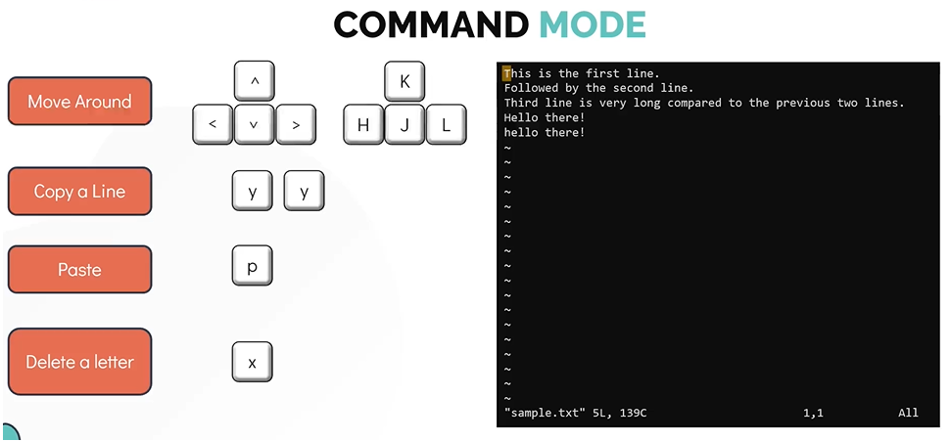
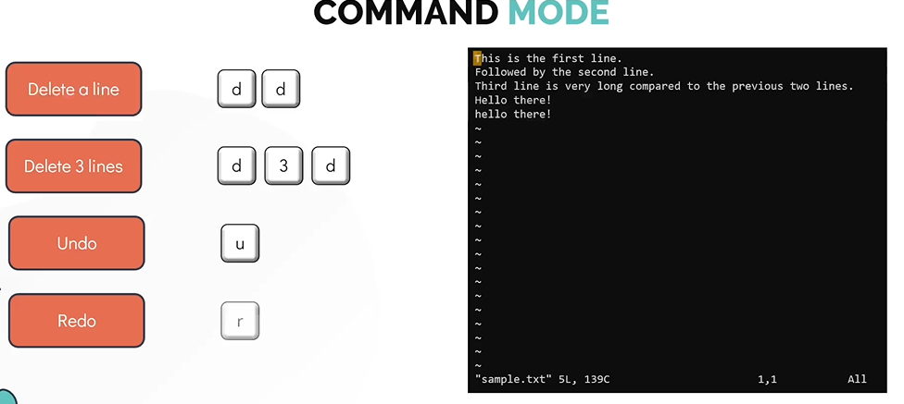

Slide 17
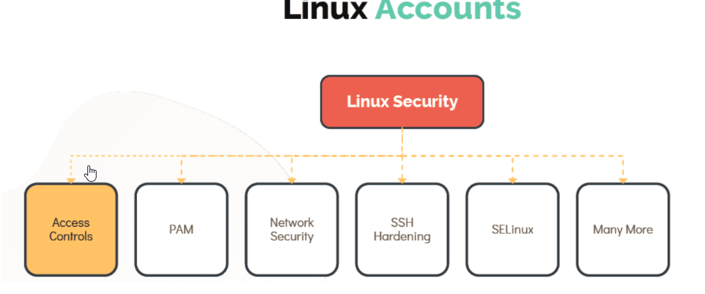
Security and File Permissions – Linux Accounts
Notes:
User Accounts
User's informations are stored under /etc/passwd file.
[~]$ cat /etc/passwd
Information about groups is stored into /etc/group file.
[~]$ cat /etc/group
Each user has a username and a unique ID assigned to them known as user ID or UID.
The user also has a GID, the group id they are part of, id command can be use to check these details. for eg:
[~]$ id michael uid=1001(michael) gid=1001(michael)groups=1001(michael),1003(developers)
More details about the user account can be found eg. default shell, home directory using.
[~]$ grep -i michael /etc/passwd michael:x:1001:1001::/home/michael:/bin/sh
To see the list of users currently logged use who command.
[~]$ who bob pts/2 Apr 28 06:48 (172.16.238.187)
The last command displays the record of all logged-in users along with the date and time when the system was rebooted.
[~]$ last michael :1 :1 Tue May 12 20:00 still logged in sarah :1 :1 Tue May 12 12:00 still running reboot system boot 5.3.0-758-gen Mon May 11 13:00 - 19:00 (06:00)
Switching users
To switch to any user use su command.
[~]$ su – Password: root ~#
To run a specific command you can use su -c "whoami" (This is not recommended way)
[michael@ubuntu-server ~]$ su -c "whoami" Password: root
To run a command as a root user sudo command is recommended.
[michael@ubuntu-server ~]$ sudo apt-get install nginx [sudo] password for michael:
Users listed in /etc/sudoers file can make use of sudo command for privledge escalation.
[~]$ cat /etc/sudoers

Slide 18
Security and File Permissions – User Management
User Add
Managing Users
Notes:
User Add
To create a new local user bob in the system use useradd command.
[~]$ useradd bob
To get more details about bob account like, home director, uid, and shell use /etc/passwd
[~]$ grep -i bob /etc/passwd bob:x:1002:1002::/home/bob:/bin/sh
To check the uid or username of the user logged in user whoami command.
[~]$ whoami bob
All user's password are store under /etc/shadow
[~]$ grep -i bob /etc/shadow bob:!:18341:0:99999:7:::
To change the password of current user use passwd or for any specific user use passwd <username>
[~]$ passwd bob Changing password for user bob. New UNIX password: Retype new UNIX password: passwd: all authentication tokens updated successfully.
useradd command be used along with many attributes as show below.
[~]$ useradd -u 1009 -g 1009 -d /home/robert -s /bin/bash -c ”Mercury Project member" bob
To delete a user use userdel command
[~]$ userdel bob
To add a group use groupadd command
[~]$ groupadd –g 1011 developer
To delete a group user groupdel command
[~]$ groupdel developer

Slide 19
Security and File Permissions – Access Control Files
Control files
Notes:
To get more details about one's account for example bob account, home director, uid, and shell check /etc/passwd
[~]$ grep -i ^bob /etc/passwd bob:x:1002:1002::/home/bob:/bin/sh USERNAME:PASSWORD:UID:GID:GECOS:HOMEDIR:SHELL
Password are stored under /etc/shadow
[~]$ grep -i ^bob /etc/shadow bob:$6$0h0utOtO$5JcuRxR7y72LLQk4Kdog7u09LsNFS0yZPkIC8pV9tgD0wXCHutY cWF/7.eJ3TfGfG0lj4JF63PyuPwKC18tJS.:18188:0:99999:7::: USERNAME:PASSWORD:LASTCHANGE:MINAGE:MAXAGE:WARN:INACTIVE:EXPDATE
Check the groups bob belongs too
[~]$ grep -i ^bob /etc/group NAME:PASSWORD:GID:MEMBERS

Slide 20
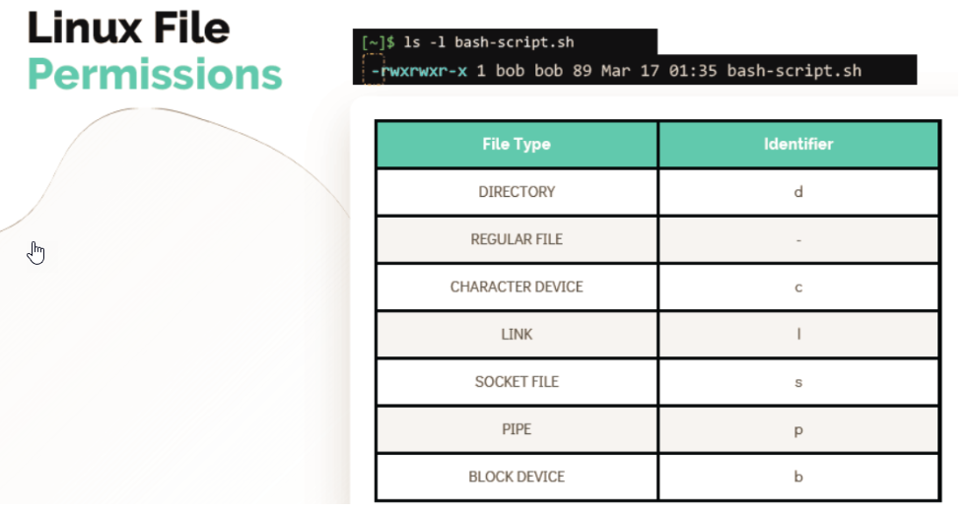
LINUX FILE PERMISSIONS
Notes:
In this lecture we will learn about various file type identifiers.
We will also learn about various Linux file permissions that can be applied on the file or the directory.

Slide 21
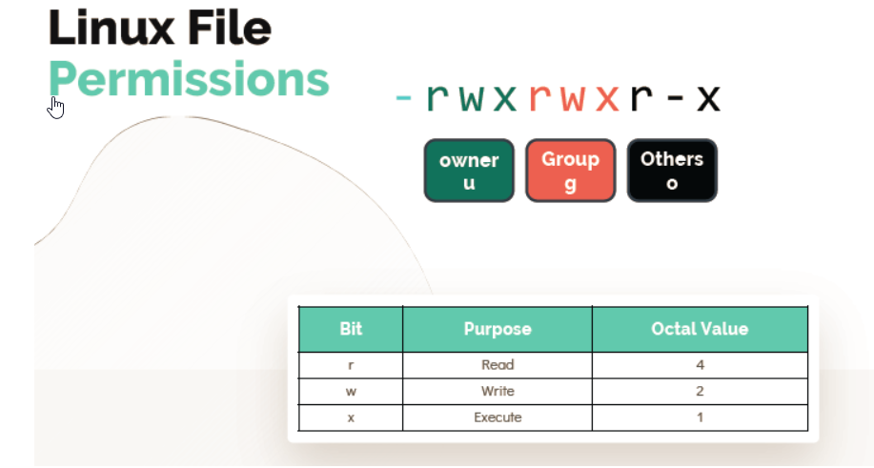
LINUX FILE PERMISSIONS
Notes:
Directory Permission
To list the directory permission use
[~]$ ls -ld /home/bob/random_dir
To know the current user
[~]$ whoami
To change the change the directory
[~]$ cd /home/bob/random_dir

Slide 22
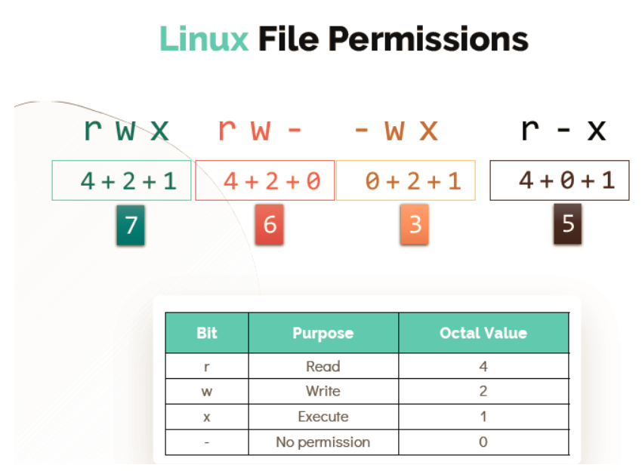
LINUX FILE PERMISSIONS
Notes:
Modifying file permissions
Use chmod command to modify the file permissions.
Provide full access to owners
[~]$ chmod u+rwx test-file
Provide Read access to Owners, groups and others, Remove execute access
[~]$ chmod ugo+r-x test-file
Remove all access for others
[~]$ chmod o-rwx test-file
Full access for Owner, add read , remove execute for group and no access for others
[~]$ chmod u+rwx,g+r-x,o-rwx test-file
Provide full access to Owners, group and others
[~]$ chmod 777 test-file
Provide Read and execute access to Owners,groups and others
[~]$ chmod 777 test-file
Read and Write access for Owner and Group, No access for others.
[~]$ chmod 660 test-file
Full access for Owner, read and execute for group and no access for others.
[~]$ chmod 750 test-file
Change Ownership
Changes owner to bob and group to developer
[~]$ chown bob:developer test-file
Changes just the owner of the file to bob. Group unchanged.
[~]$ chown bob andoid.apk
Change the group for the test-file to the group called android.
[~]$ chgrp android test-file

Slide 23
SSH and SCP
SSH is used to login to the remote computer.
SCP is used to copy of files/directories within the file system also can copy data to remote computer.
Notes:
SSH
To login to the remote server use ssh command with hostname or IP address.
ssh <hostname OR IP Address>
To login to the remote server with specific username and password.
ssh <user>@<hostname OR IP Address>
-l attribute can also be used as
ssh –l <user> <hostname OR IP Address>
Password-Less Authentication
Passwordless authentication can be setup via key-pair authentication in order to login to the remote server with password.
Public and Private key are stored at below location.
Public Key: /home/bob/.ssh/id_rsa.pub
Private Key: /home/bob/.ssh/id_rsa
To generate a keypair on the Client run this command
bob@caleston-lp10 ~]$ ssh-keygen –t rsa
To copy the Public key from the client to the remote server
bob@caleston-lp10 ~]$ ssh-copy-id bob@devapp01
Now Bob can login to remote server without password
[bob@caleston-lp10 ~]$ ssh devapp01
SCP
To copy a compresses file to a remote server
bob@caleston-lp10 ~]$ scp /home/bob/caleston-code.tar.gz devapp01:/home/bob
To copy a directory to a remote server
[bob@caleston-lp10 ~]$ scp –pr /home/bob/media/ devapp01:/home/bob

Slide 24
IPTABLES
Iptables uses a set of tables that have chains that contain a set of built-in or user-defined rules.
The two types of tables/rules:
FILTER – this is the default table, which contains the built-in chains for: INPUT – packages destined for local sockets. FORWARD – packets routed through the system. OUTPUT – packets generated locally.
NAT – a table that is consulted when a packet tries to create a new connection. It has the following built-in: PREROUTING – used for altering a packet as soon as it’s received. OUTPUT – used for altering locally-generated packets. POSTROUTING – used for altering packets as they are about to go out.
Notes:
For installing IPtables in Ubuntu servers,
bob@devapp01:~$sudo apt install iptables
To list the iptables rules,
bob@devapp01:~$sudo iptables -L Chain INPUT (policy ACCEPT) target prot opt source destination Chain FORWARD (policy ACCEPT) target prot opt source destination Chain OUTPUT (policy ACCEPT) target prot opt source destinatio
To allow incoming connection from IP 172.16.238.187 to port 22 and 80, you can run the following command.
sudo iptables -A INPUT -p TCP -s 172.16.238.187 --dport 22 -j ACCEPT
sudo iptables -A INPUT -p TCP -s 172.16.238.187 --dport 80 -j ACCEPT
To list the iptables rules,
bob@devapp01:~$ sudo iptables -L Chain INPUT (policy ACCEPT) target prot opt source destination ACCEPT tcp -- caleston-lp10 anywhere tcp dpt:ssh ACCEPT tcp -- caleston-lp10 anywhere tcp dpt:http Chain FORWARD (policy ACCEPT) target prot opt source destination Chain OUTPUT (policy ACCEPT) target prot opt source destination

Slide 25
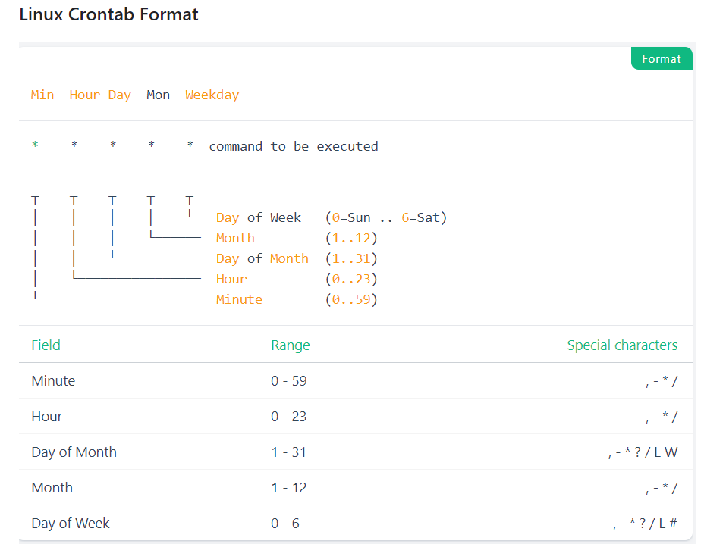
Cronjob in Linux
The basic usage of cron is to execute a job in a specific time. The crontab is a list of commands that you want to run on a regular schedule, and also the name of the command used to manage that list. Crontab stands for cron table because it uses the job scheduler cron to execute tasks. The schedule is called the crontab, which is also the name of the program used to edit that schedule.
Notes:
Crontab Examples
*/30 * * * * Every 30 mins
0 * * * * Every hour
0 0 * * 0 At midnight of every Sunday
0 0 0 15 * * Every 15th of month (monthly)
0 0 0 1 1 * Every 1st of january (yearly)
@reboot Every reboot

